Slide 1
Bank Management System
Dhruv E23CSEU1031
Divyansh Jain E23CSEU1042
Parth Azad E23CSEU1032
.

Slide 2
INTRODUCTION
The Bank Management System project is a model Internet Banking Site.
This site enables the customers to perform the basic banking transactions by sitting at their office or at homes through PC or laptop.
The system provides the access to the customer to create an account, deposit/withdraw the cash from his account, generate statement, enquire balance, change pin
This project has been developed to carry out the processes easily and quickly, which is not possible with the manuals systems, which are overcome by this software.
The primary aim of this Bank Management System is to provide an improved design methodology, which envisages the future expansion, and modification, which is necessary for a core sector like banking. This necessitates the design to be expandable and modifiable and so a modular approach is used in developing the application software.

Slide 3
Objective Of The Project
To enable the Customers to perform the basic banking transactions online.
To keep the information of Customer Transactions.
To keep the Interface user-friendly for Customer.
To get better understanding of Online Banking System and activities performed by various roles in the banking sector.
To save the time by Providing Banking Services Online.

Slide 4
Individual Responsibilities
Technologies Used - JAVA BASICS , My SQL , JDBC , JAVA SWING , JAVA AWT
Dhruv – Login , Sign Up, Pin Change, Deposit
Divyansh Jain – Cash Withdraw, Fast Cash
Parth Azad – Balance Enquiry , Mini Statement

Slide 5
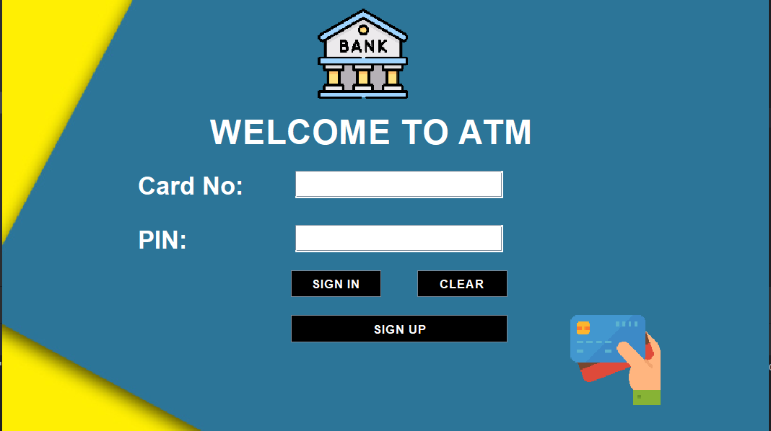
Login
Here Customer can login to their respective accounts by entering their card number and pin.
Or They Can Create a New Account .

Slide 6

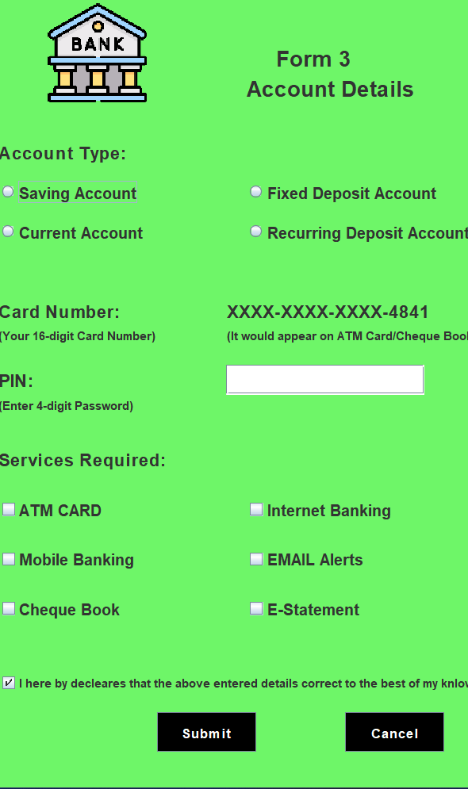
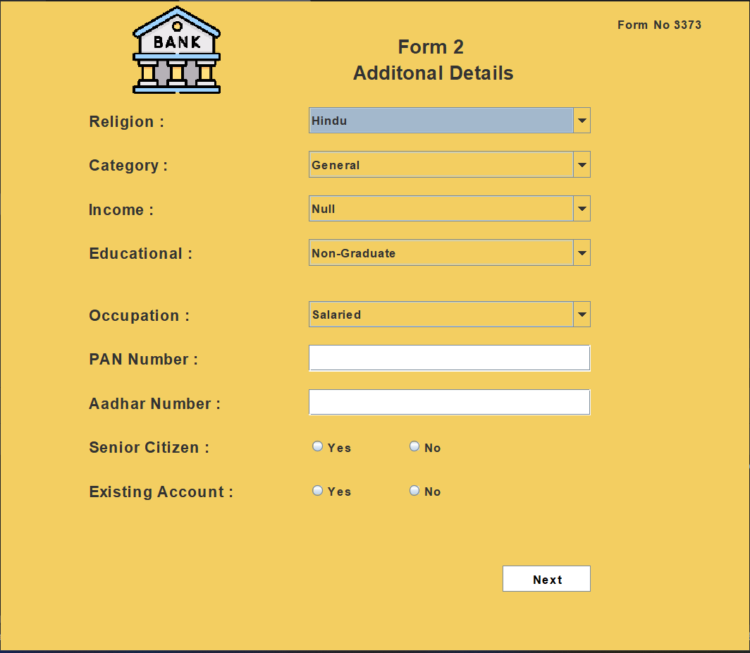
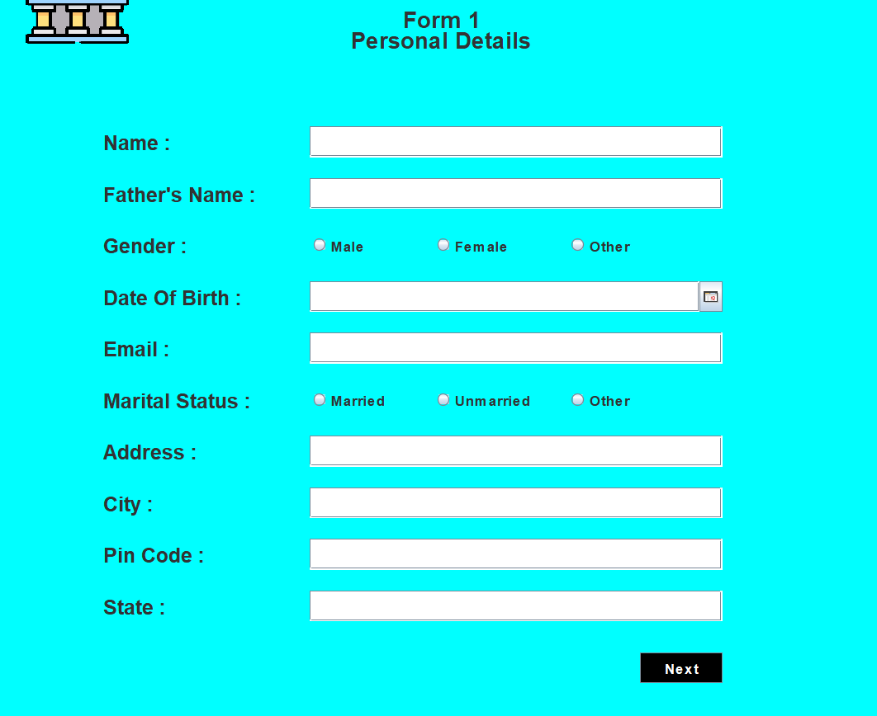
Sign Up
Here New Customers will Sign Up to Create their accounts.
Customers have to Enter their
Personal Details
Additional Details
Some Account Details
Submit Button Will Generate Account Number and Save Details

Slide 7
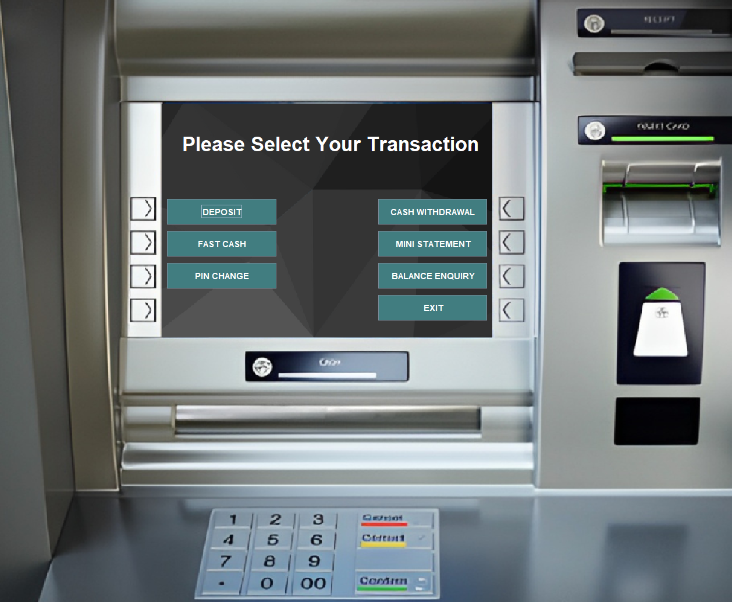
Main Window
Here Customers can Click on the displayed buttons to avail the services mentioned.
By This Customer will be redirected to the linked Page.
Customers can Click on Exit Button to Close the Screen.

Slide 8
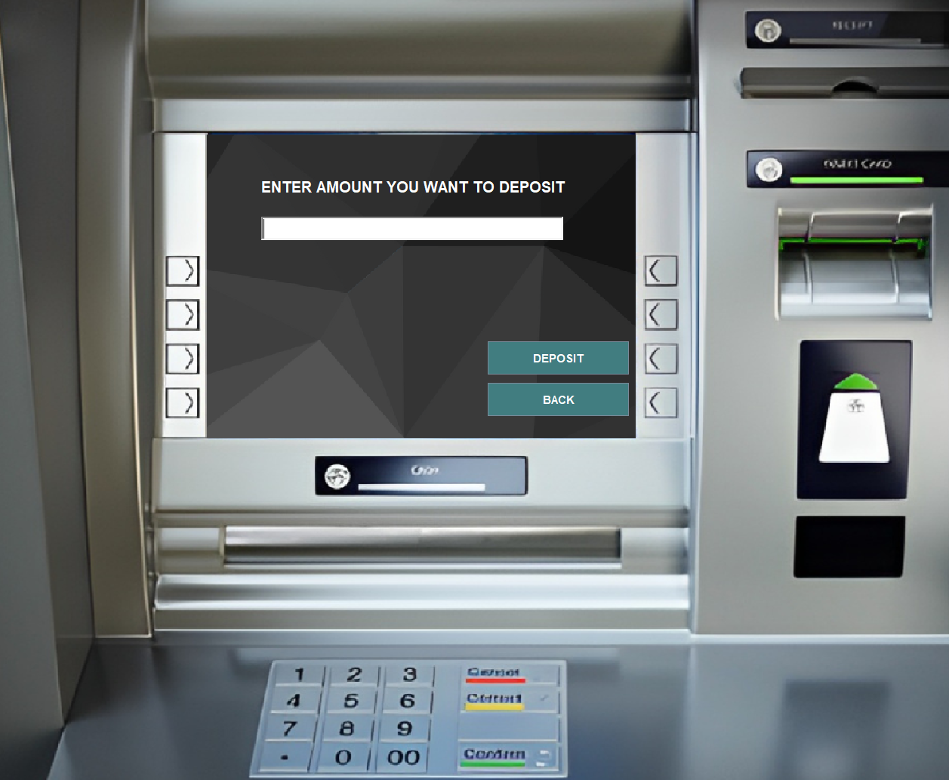
Deposit
Here Customers Can Enter the Amount they Want to Deposit.
Clicking on Deposit Button will display Amount deposited successfully.
Back Button will redirect to Main Window

Slide 9
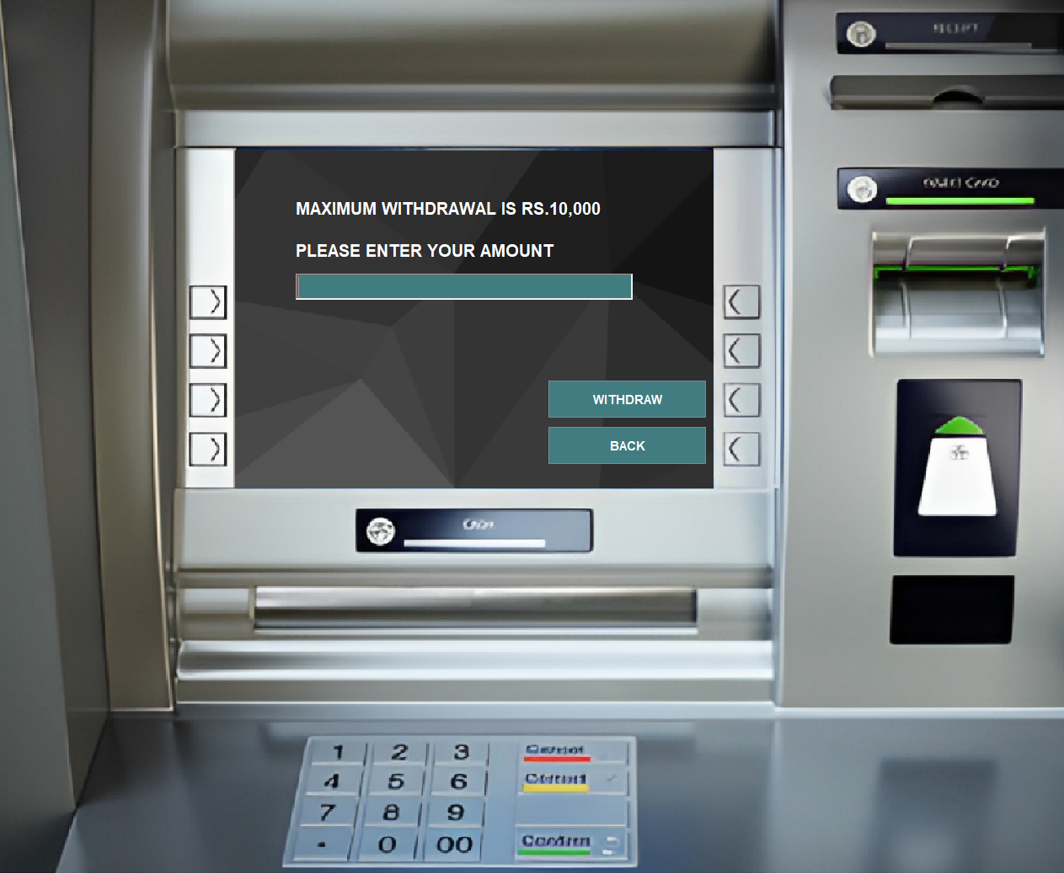
Cash Withdrawal
Here Customer will Enter the Amount They Want to Withdraw.
Clicking on Withdraw Button will display message Amount Debited
If Current Balance is less than Amount Entered, Insufficient Funds message will be displayed.
Back Button will redirect to Main Window.

Slide 10
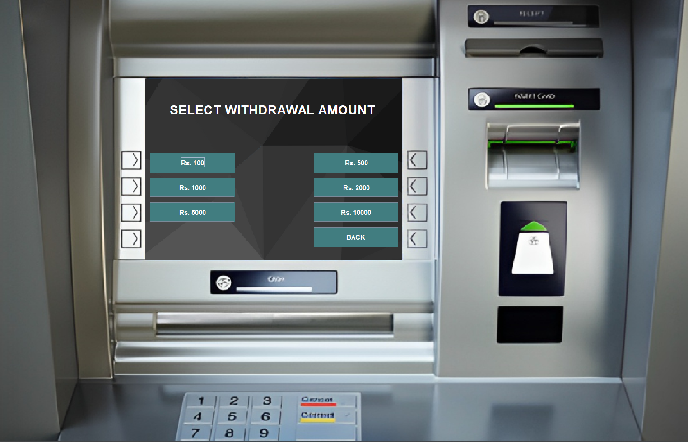


Fast Cash
Here Customer Can Withdraw Cash Using Some Predefined Amount Options.
Clicking on Buttons with Amounts will display message Amount Debited.
If Current Balance is less than Amount Selected , Insufficient Funds message will be displayed.
Back Button will redirect to Main Window.

Slide 11
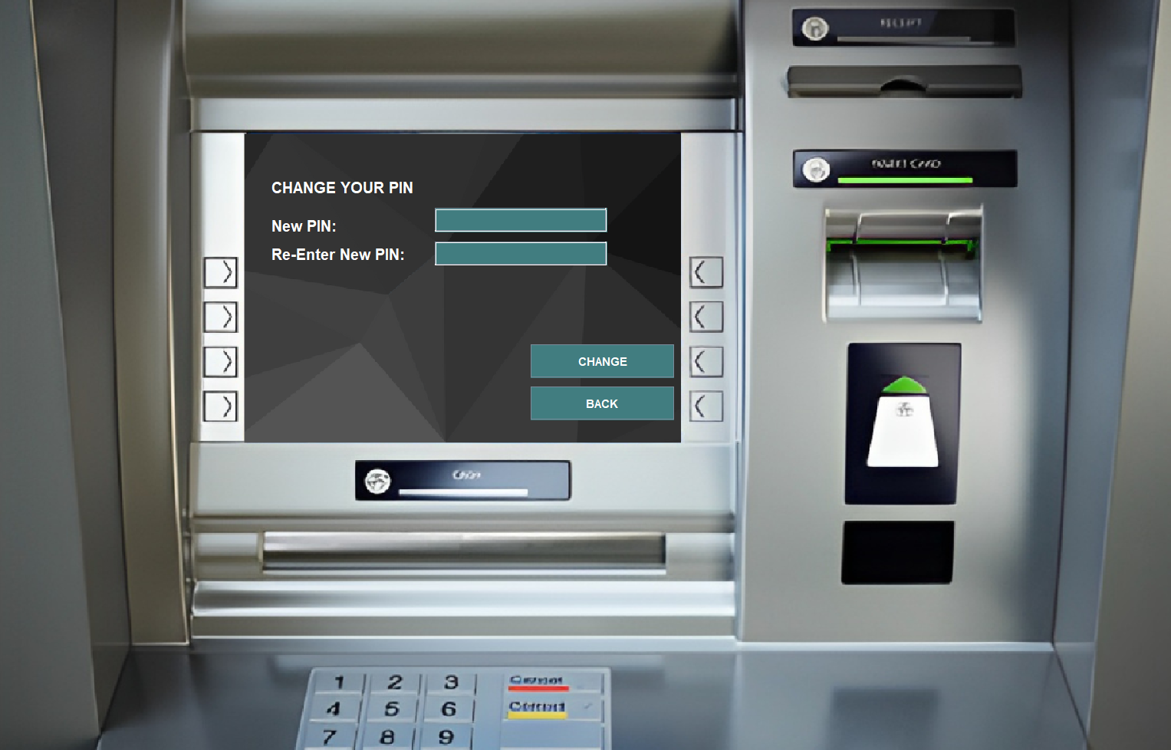
PIN Change
Here Customer Can Change Their Account PIN By Clicking On CHANGE Button.
Message appears if Both Fields does not match or any field is empty or PIN entered is not 4-digit.
Back Button will redirect to Main Window.

Slide 12
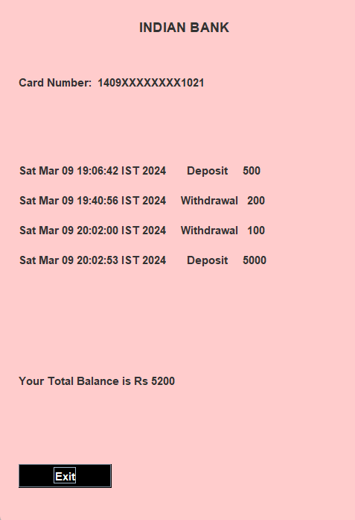
Mini Statement
Here Customer Can Get a Mini Statement of their Transactions By Clicking on MINI STATEMENT Button.
Mini Statement Contains recent Transactions including Date, Time , Amount And Type of Transaction.
EXIT Button will redirect to Main Frame.

Slide 13
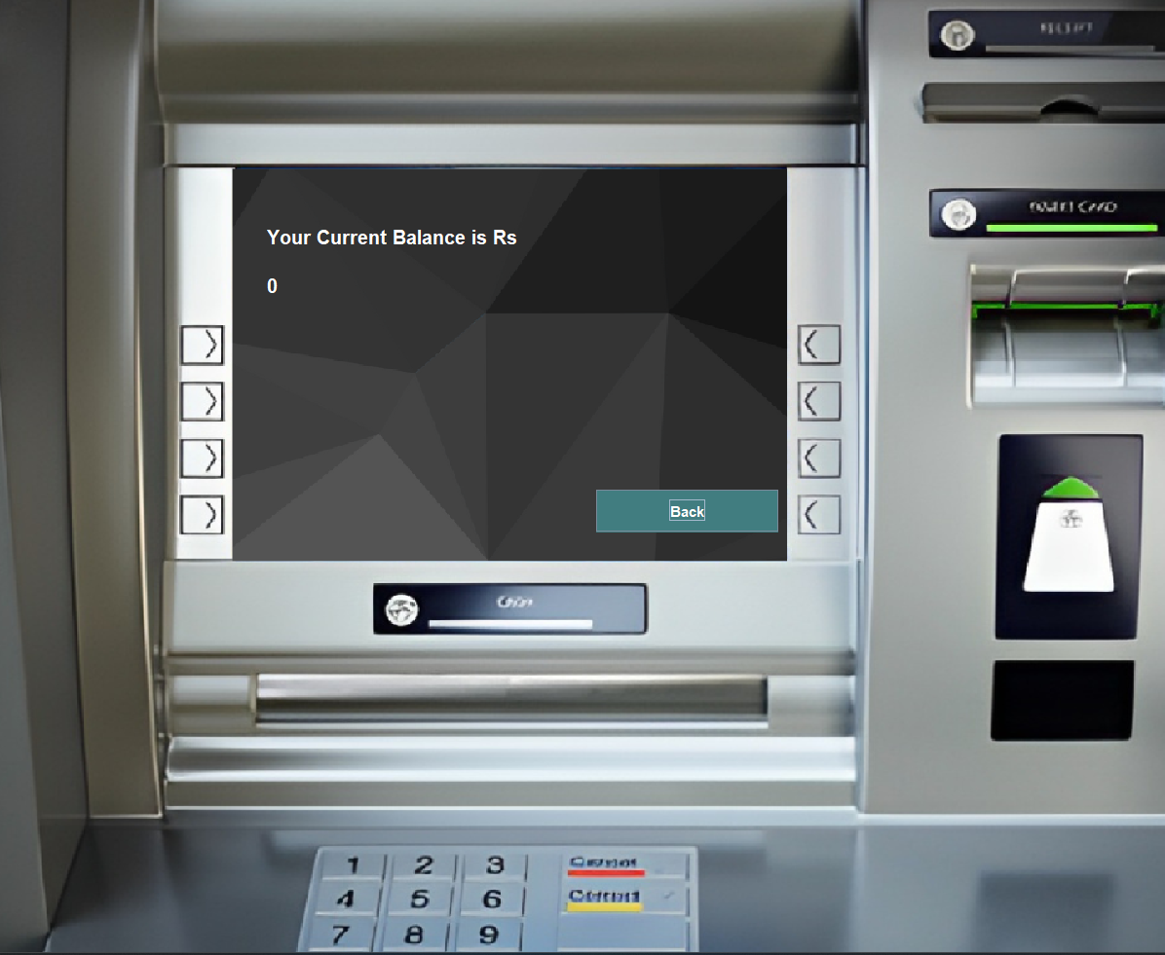
Balance Enquiry
Here Customers Can See Their Current Balance.
Back Button will redirect to Main Window.

Slide 14
CONCLUSION
It is a software which helps the user to work with the bank services like
opening a new account, Cash Deposit , Cash Withdraw , PIN Change , Balance Enquiry .
This software reduces the amount of manual data entry and gives
greater efficiency. The User Interface of it is very friendly and can be easily
used by anyone.
It also decreases the amount of time taken to Write Account Details, Transaction History etc.

Slide 15

THANK YOU

